Slide 1
TPF And Kaching’s Product Case Study
Inter IIT Tech Meet’ 21
IIT Guwahati
Pulkit Mahajan ( Team Leader )
Dhiraj Pimparkar
Soubhav Gupta
Nishita Phillip

Slide 2

Problem Statement
After the profile is scanned using Kaching’s scanner application, an intern sends out DMs to each new referrer, receives UPI IDs, processes payouts manually and then informs them after transaction is completed. If the referrer is already in Kaching’s database then transaction is made directly without the initial DM and the referrer is thanked.
Since the number of referrals are growing day by day, the procedure needs to be automated.

Slide 3
Highlights of our Solution
DM-ing the user for his UPI
Sending Details for payout
Autofill Bank/UPI ID detail
Notify referrer (transaction link)
Thanking the user (If successful)
Asking to resend Details(If unsuccessful)
Kaching Dashboard
Messaging server
Payout Server
Users

Slide 4
Case 1: New referrer (User ID not listed in Kaching Dashboard)
Sends User ID and Platform
Requests user to send his details
Sends back his details
Kaching Dashboard
Messaging Server
Messaging Server
User
User details updated in dashboard
Status of Payment
(success or failure)
Status of Payment
(success or Failure)
User details for payout initiation
Kaching Dashboard
(updated with user details)
Kaching Dashboard
Messaging Server
(For final DM)
Payout Server
Informing user the status of payment
User

Slide 5
Case 2 : Referrer already listed in Kaching Dashboard
Status of Payment
(success or Failure)
User details for payout initiation
Kaching Dashboard
Payout Server
Kaching Dashboard
(updated with user details)
Status of Payment
(success or Failure)
Informing user the status of payment
Messaging Server
(For final DM)
User

Slide 6
Creating DMs :
SOLUTION TO CROSS
PLATFORM MESSAGING
Matrix is the
solution!
BENEFITS
Interoperability
Decentralized
Supports bridging to almost all platforms
Eg:- Instagram, whatsapp, facebook-messenger etc.
Open Standard
Real time
Ability to host one’s own server
Provides control over data

Slide 7
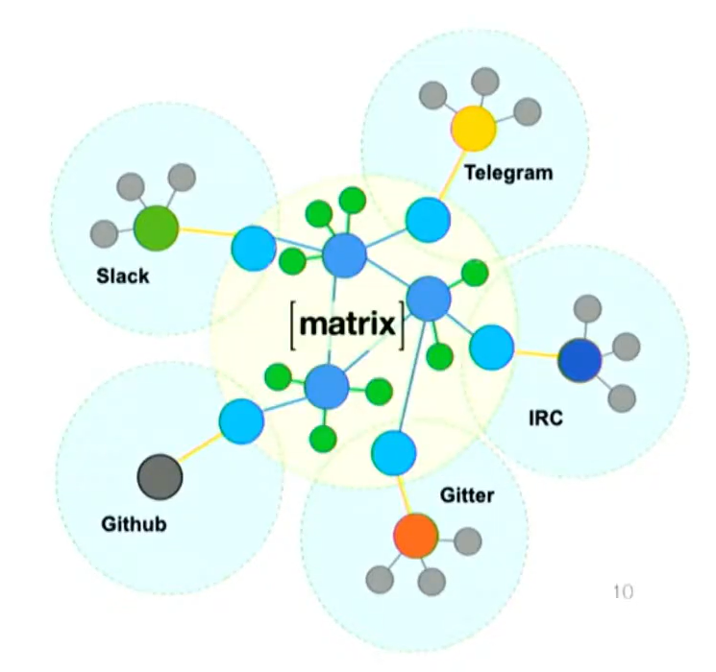
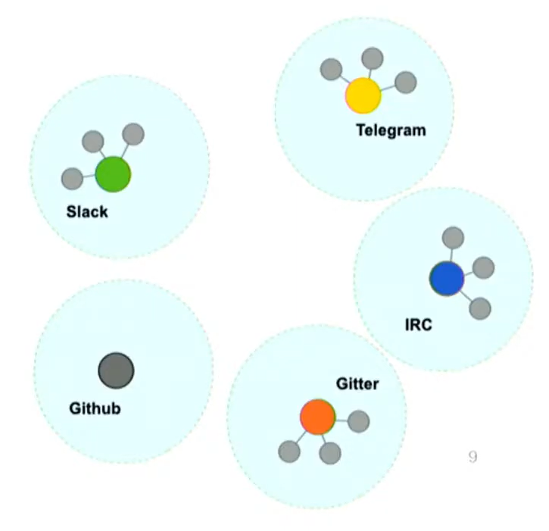
How does our solution work?
BRIDGES
Every chat platform runs on its own server.
Bridges help in ‘bridging’ your home server to remote platforms’ server.
Ability to ‘bridge’ to other chat networks
+
Ability to set up one’s own server using Synapse.
Bridge proposed in solution:
Double puppeted bridge:
Simple puppeted bridge:
Bridge logs into the remote service as a 3rd party client for that service. Kaching has to have a valid account on the remote system. The Matrix client ‘puppets’ their remote user, such that other users on the remote system aren’t even aware they are speaking to a chatbot via Matrix.
The bridge has to handle the authentication process to log into the other platform on Kaching’s behalf.
A Double puppeted bridge works in both directions, i.e., if Kaching logs into their native ig/whatsapp client and starts conversations, these should be reflected back into Matrix as if the user had done them there

Slide 8

Use of Matrix in Solution
The development team has to create a home-server using matrix in the back-end.
A chat client (or chatbot) will always remain connected to the matrix server and remain in sync in with kaching’s dashboard.
Any new entry is detected and an ID (standard framed DM) is generated via the client to the referrer whose unique user_id and platform_id will be extracted from kaching dashboard.
When the awaited reply is received a robust parser extracts UPI ID from the reply and forwards the payment request to PayTm Payout Server.

Slide 9
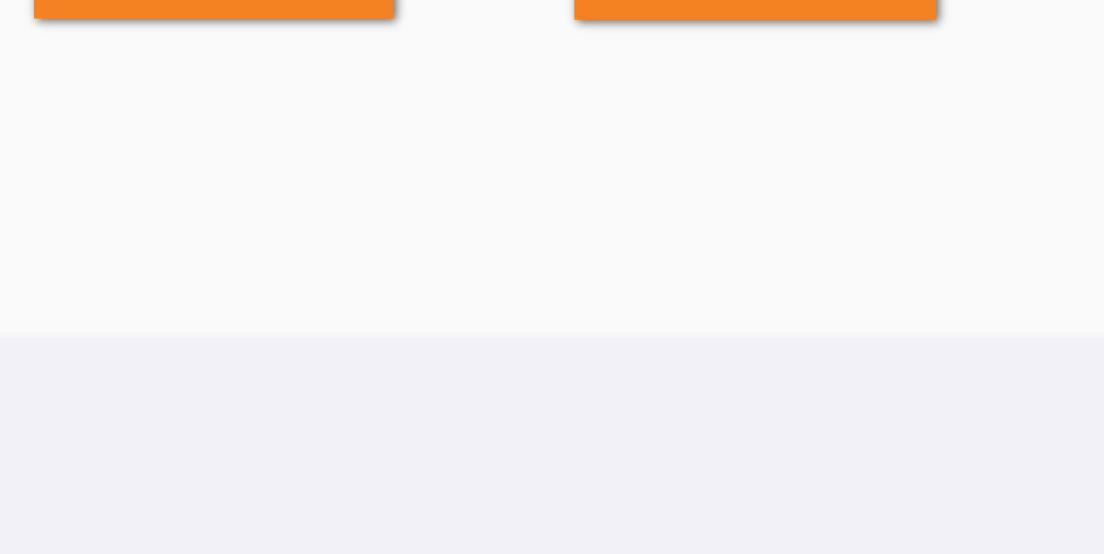
Why not Texts.com?
➔ BETA PHASE: Texts.com might be a potential solution once the alpha version is released. But for now it is in the beta testing phase.
➔ Not all people are given the access to the beta release. Furthermore, we don’t have any knowledge if texts.com would provide any APIs for building chatbots.
➔ Other cross-platform messaging apps such as Beeper are also under beta testing and can provide potential solutions in the future, but currently they cannot be relied upon.

Slide 10
Parsing the Referrer’s Reply
The parsar will loop through the reply string once and will accept only the objects matching the regular expression of UPI ID and Mobile Number.
Case 1:
Parsar finds both UPI ID and Mobile Number
Case 2:
Either or both information is missing.
Case 3:
Spammer!!
Case 4:
Unprecedented anomaly, e.g., case 2 repeating more, etc.
In case a huge number of message objects are detected that do not contain legit information, the chat room will be marked as spam and will be handled later by the intern.
Information is sent successfully to Kaching Dashboard and Dashboard is updated with user details
The chat client requests the details again.
A warning will be sent to the intern who will take over the conversation

Slide 11
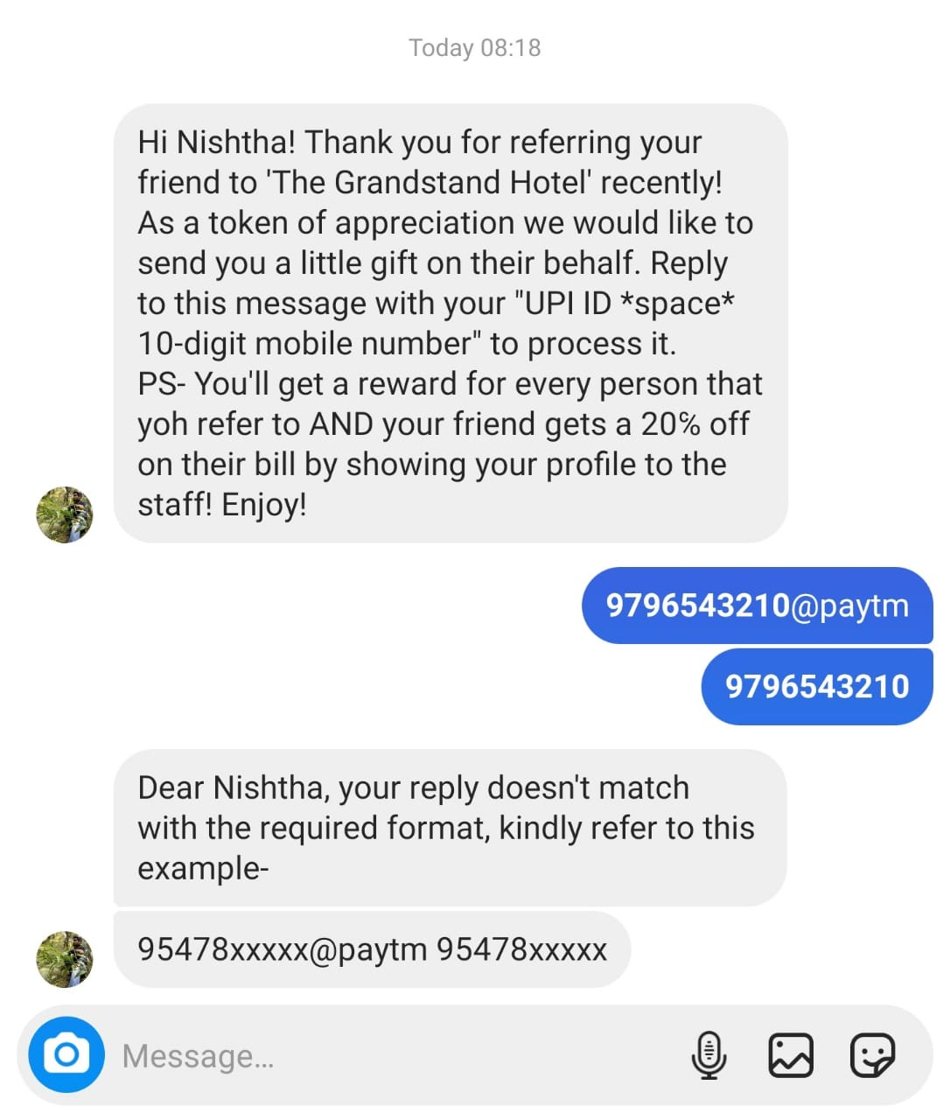
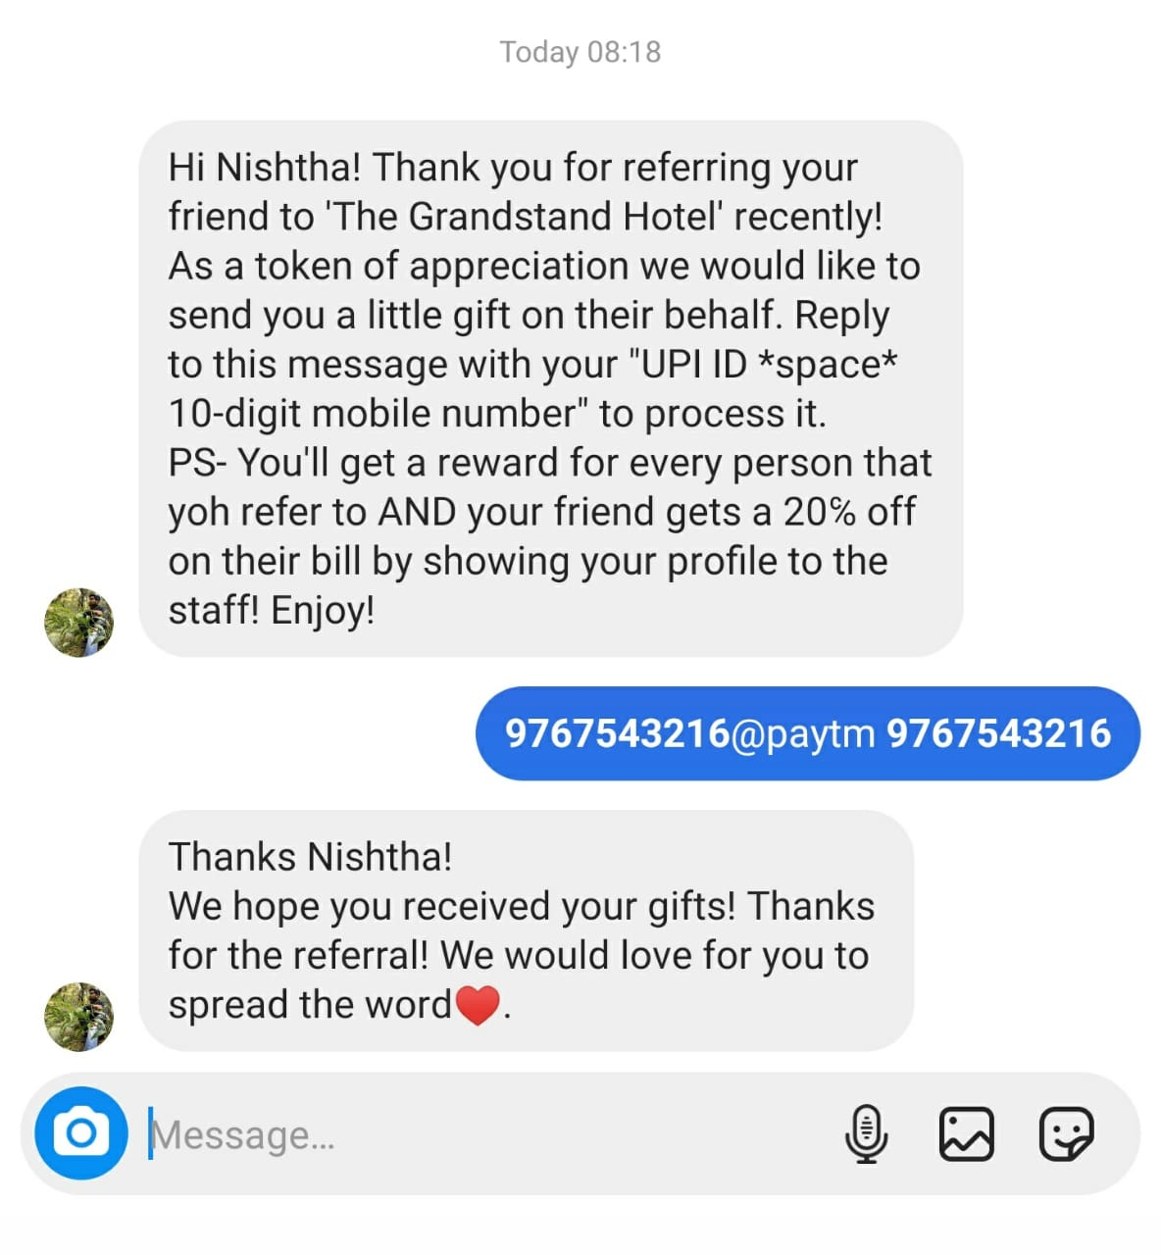
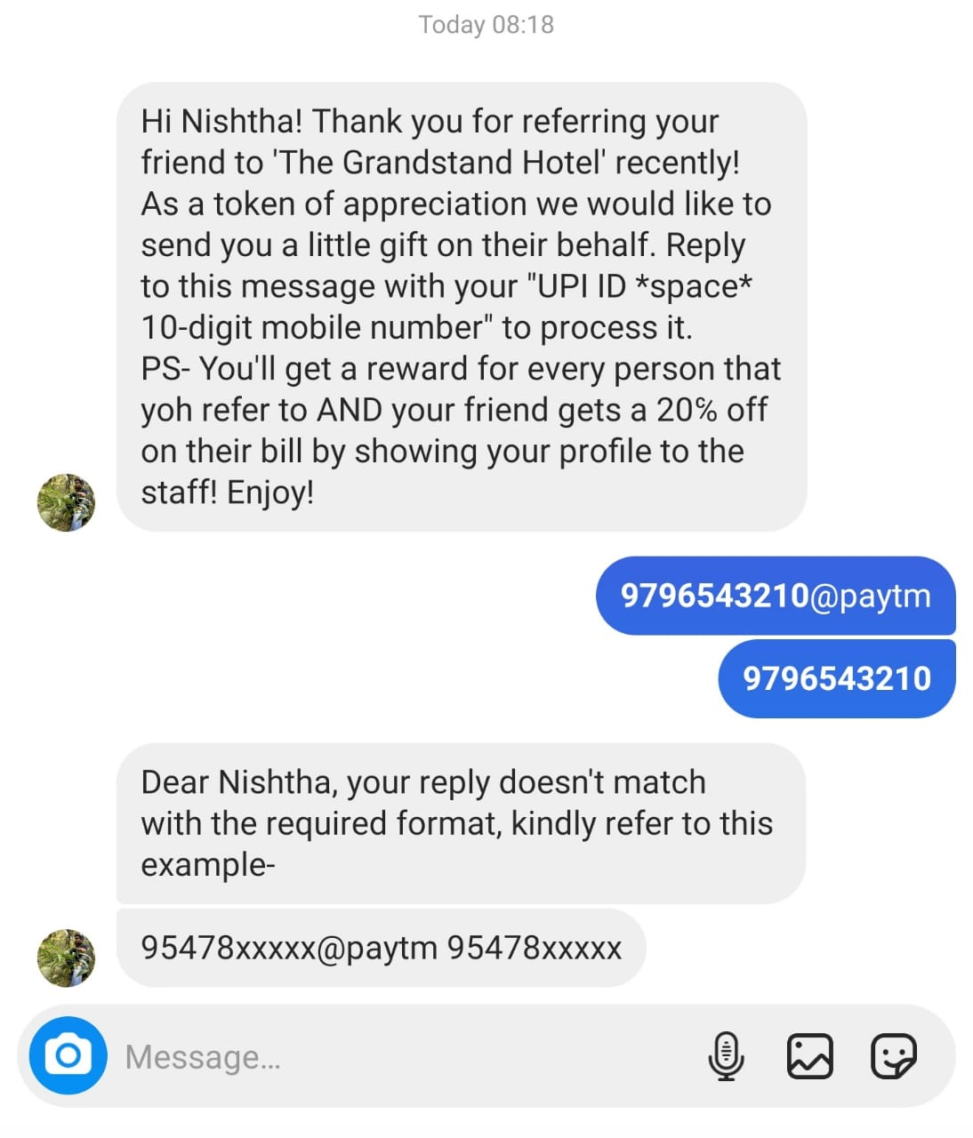
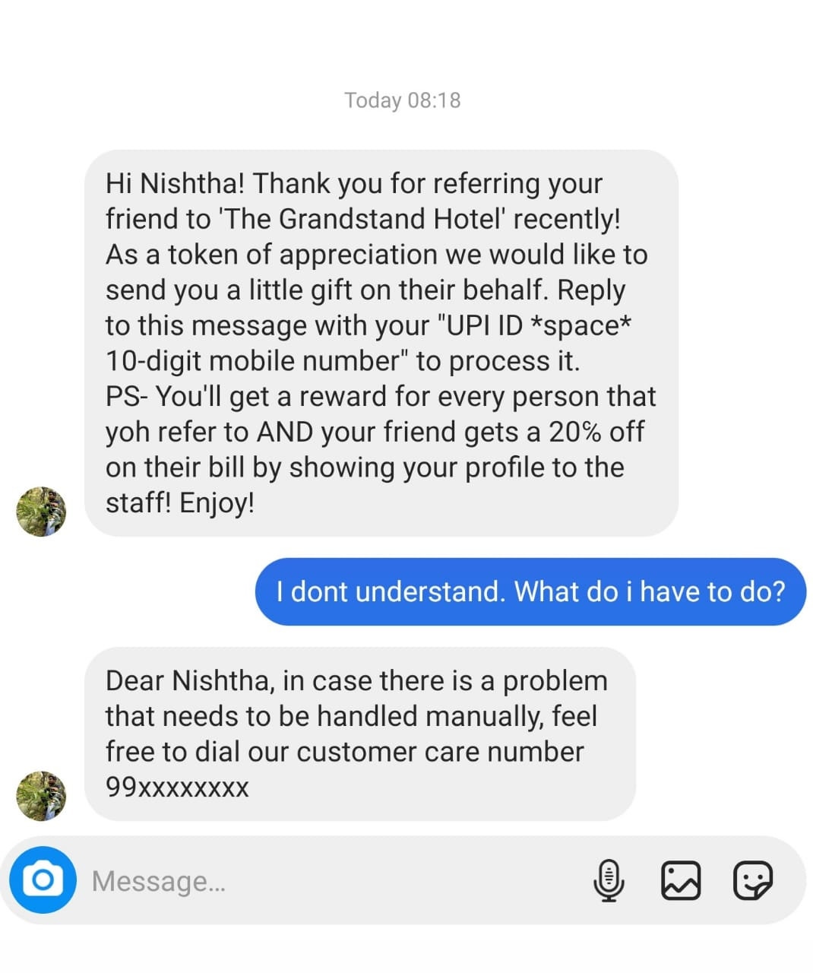

Slide 12

PayOut Server
→ We are using Wallet transfer API from Paytm payout services. It helps to disburse funds automatically from sub-wallets/disbursal accounts to user wallets(referrers) using the beneficiary mobile number or email id.
→ Disbursal Account is the account that will be used by Kaching to transfer funds to the referrers(user wallets).
→ The requirements by Wallet transfer API are : → UPI ID
→ Mobile No/Email ID
→ Amount to be transfered

Slide 13
Sends the following details and requests API to initiate the payment (Scripting)
KACHING DASHBOARD
Wallet transfer API
UPI id
Phone no./email
Amount
Sends payment status
(Success or Failure)
Updates payment status in Kaching Dashboard
Sends user status of payment
USER
Messaging Server

Slide 14
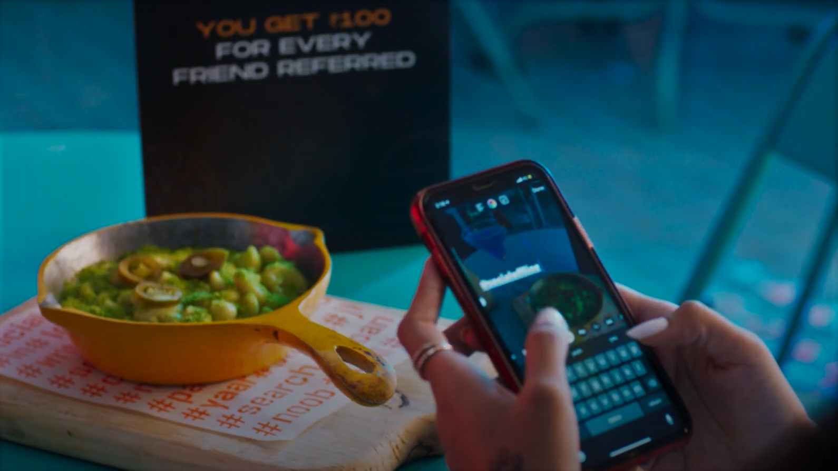
The Final DM
If payment is successful then a thanking message is sent to the referrer, by our messaging server.
If the payment fails, then kaching’s intern will manually carry forward the bot’s conversation, which will be synchronous to our messaging server because of double puppeting bridge of matrix protocol.
Thanks Nishtha!
We hope you received your gifts! Thanks for the referral. We would love for you to spread the word.

Slide 15

Thank You!

